Slide 1

SE PROJECT
Blackjack
Vlad Bratulescu & Daniel Wollmann

Slide 2
GAME RULES
21
Card
Value
Hand
Cards
Closest to 21 wins
Each card has a value
Everyone is dealt two cards
Secret
Card
Actions
Dealer has 1 face up and 1 hidden card
Each player can hit or stand
The main goal is to get 21.
Face cards count 10, Aces count 1 or 11.
Other cards keep the value.
At the beginning everyone draws two cards.
The hidden card is shown at the end.
hit = draw new card
stand = end turn

Slide 3
GAME RULES
Dealer
Winning Clause
End Game
Closest to 21 wins
Best hand wins!
All cards are revealed
The dealer draws until he has a hand value greater or equal than 17.
If a player goes over 21 he loses automatically. But if the dealer goes over 21, everyone player with a hand value under 21 wins.
At the end all drawn cards are visible and the winner is decided on!

Slide 4
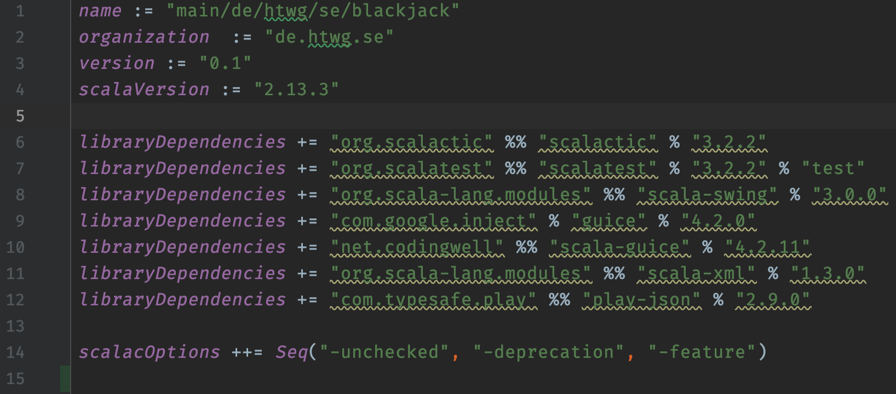
Project Setup
#1

Slide 5
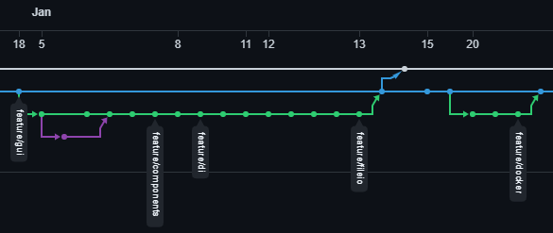
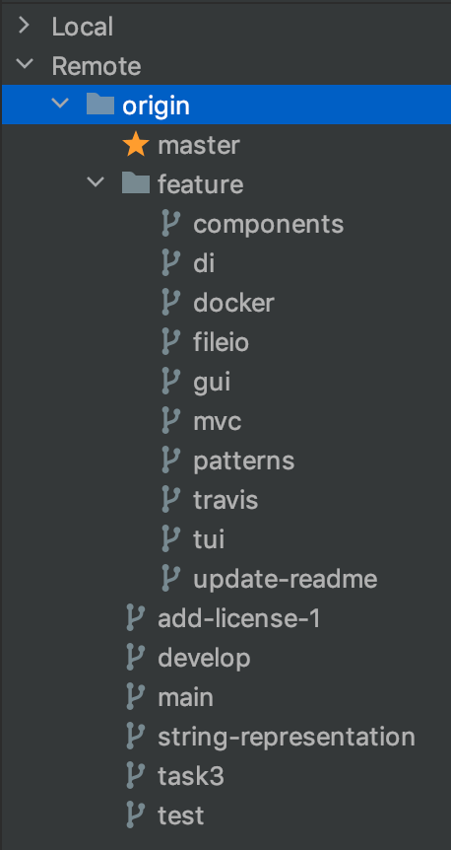
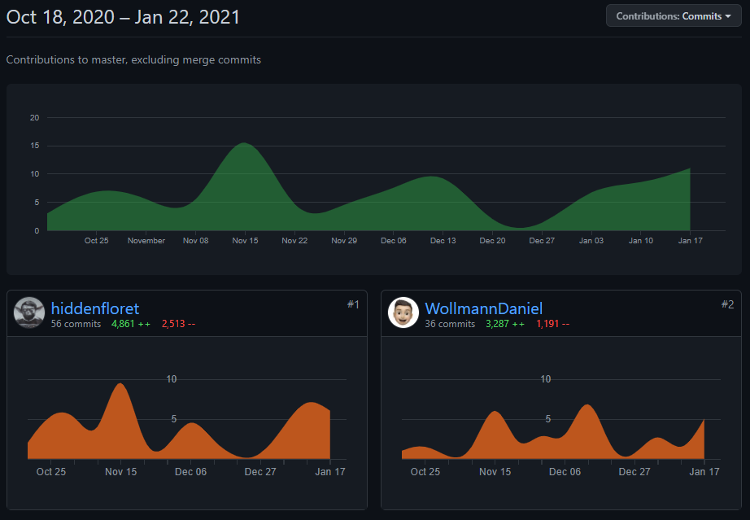
Git and Github
#2

Slide 6
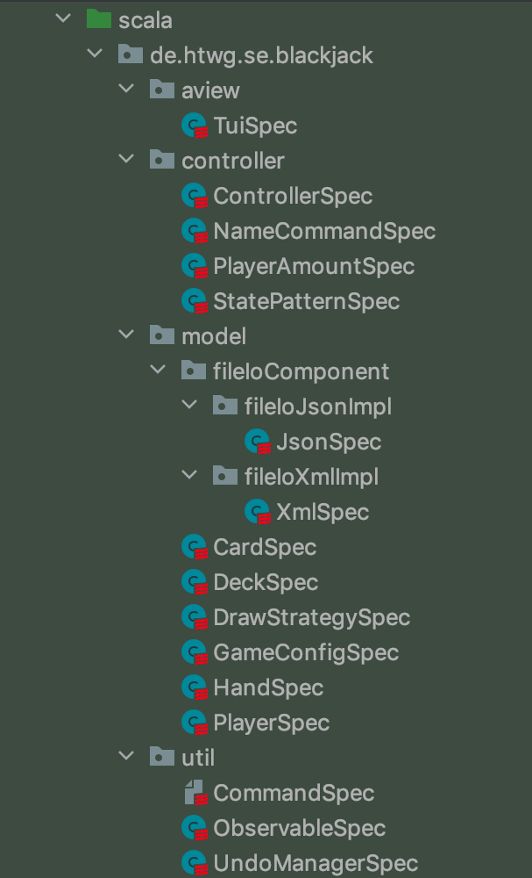
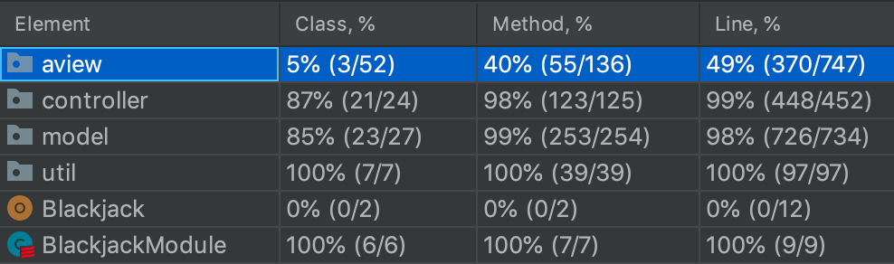
Test Coverage
#3

Slide 7
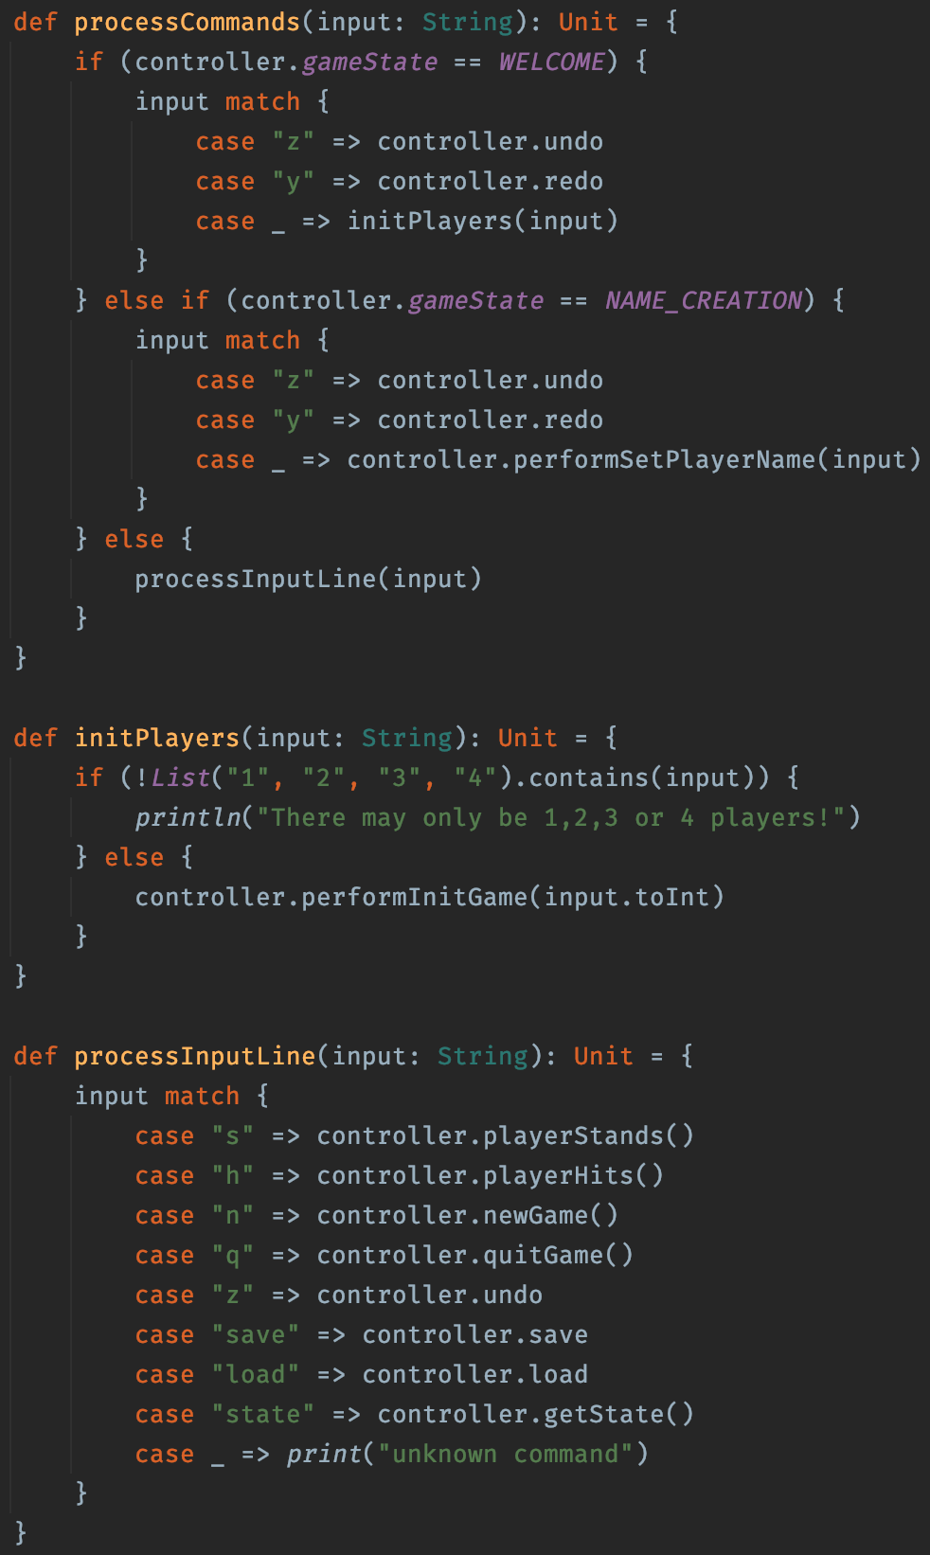
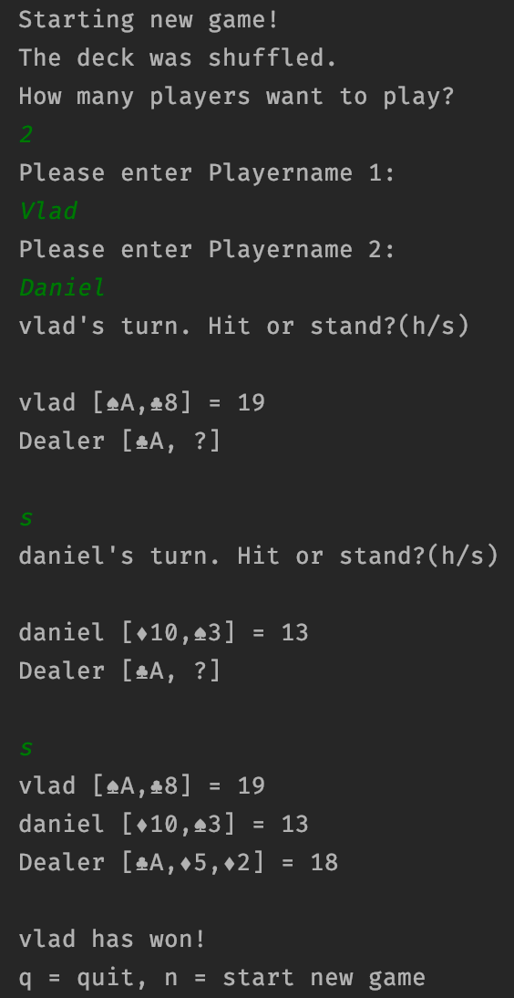
TUI
#4

Slide 8
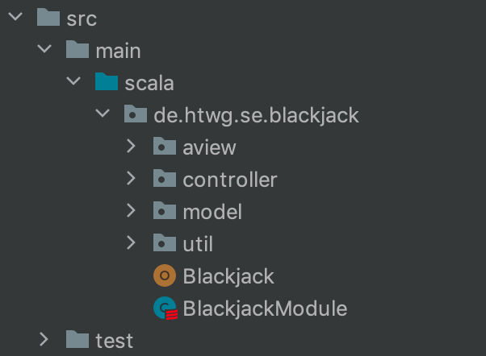
MVC
#5

Slide 9
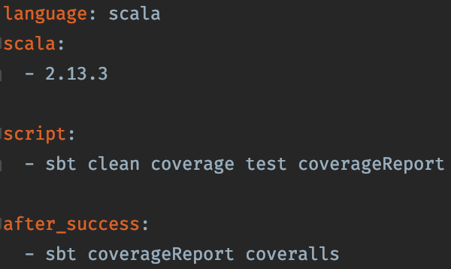
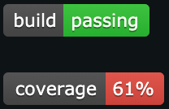
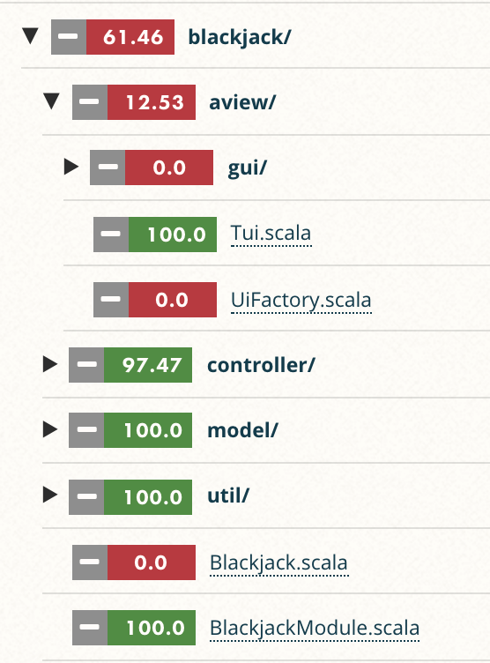
Travis + Coveralls
#6

Slide 10
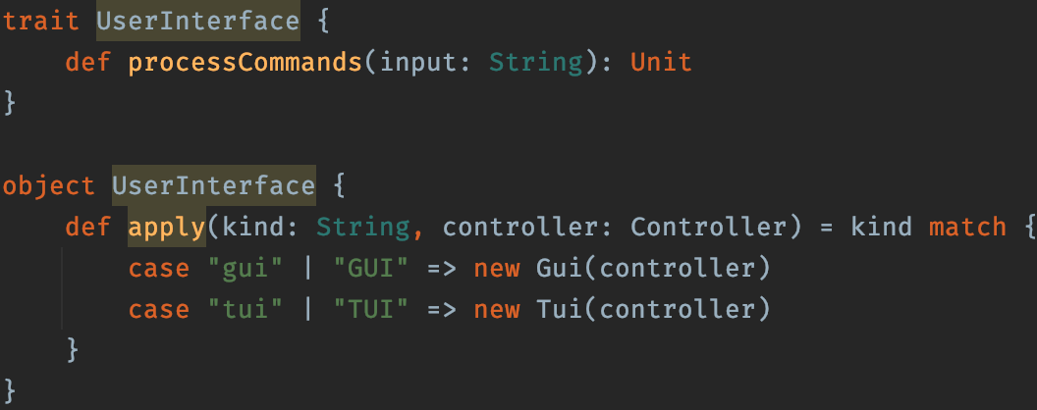
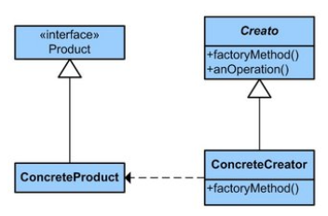
Pattern - Factory Method
#7.1
Not in use anymore

Slide 11
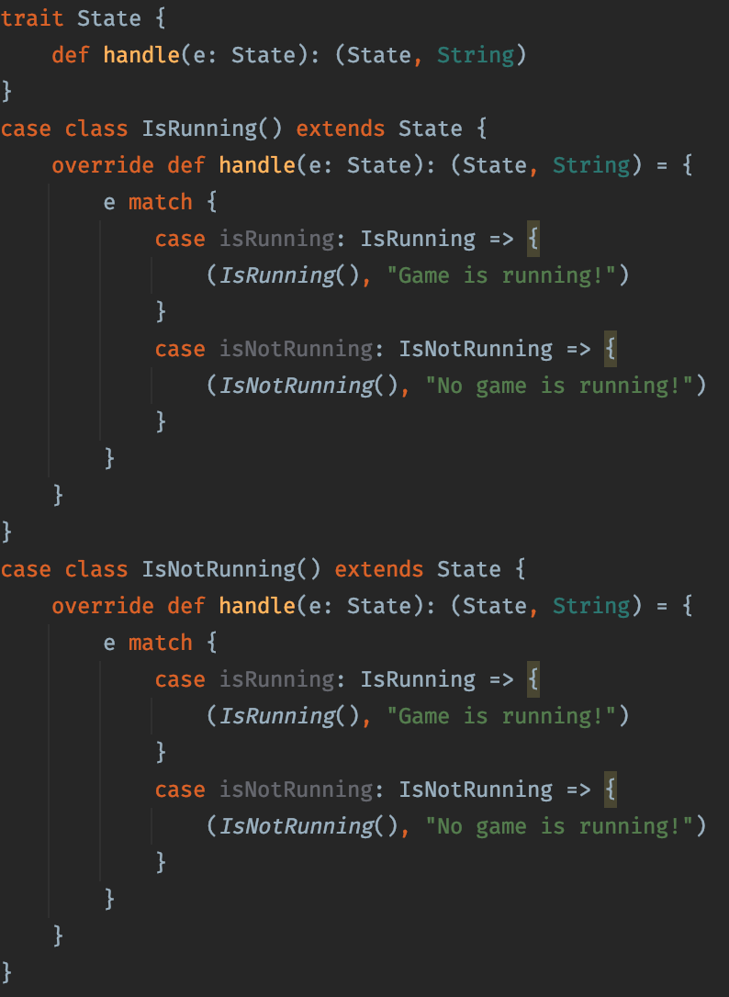
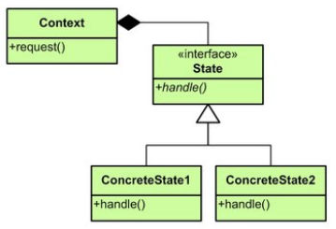
Pattern - State Pattern
#7.2

Slide 12
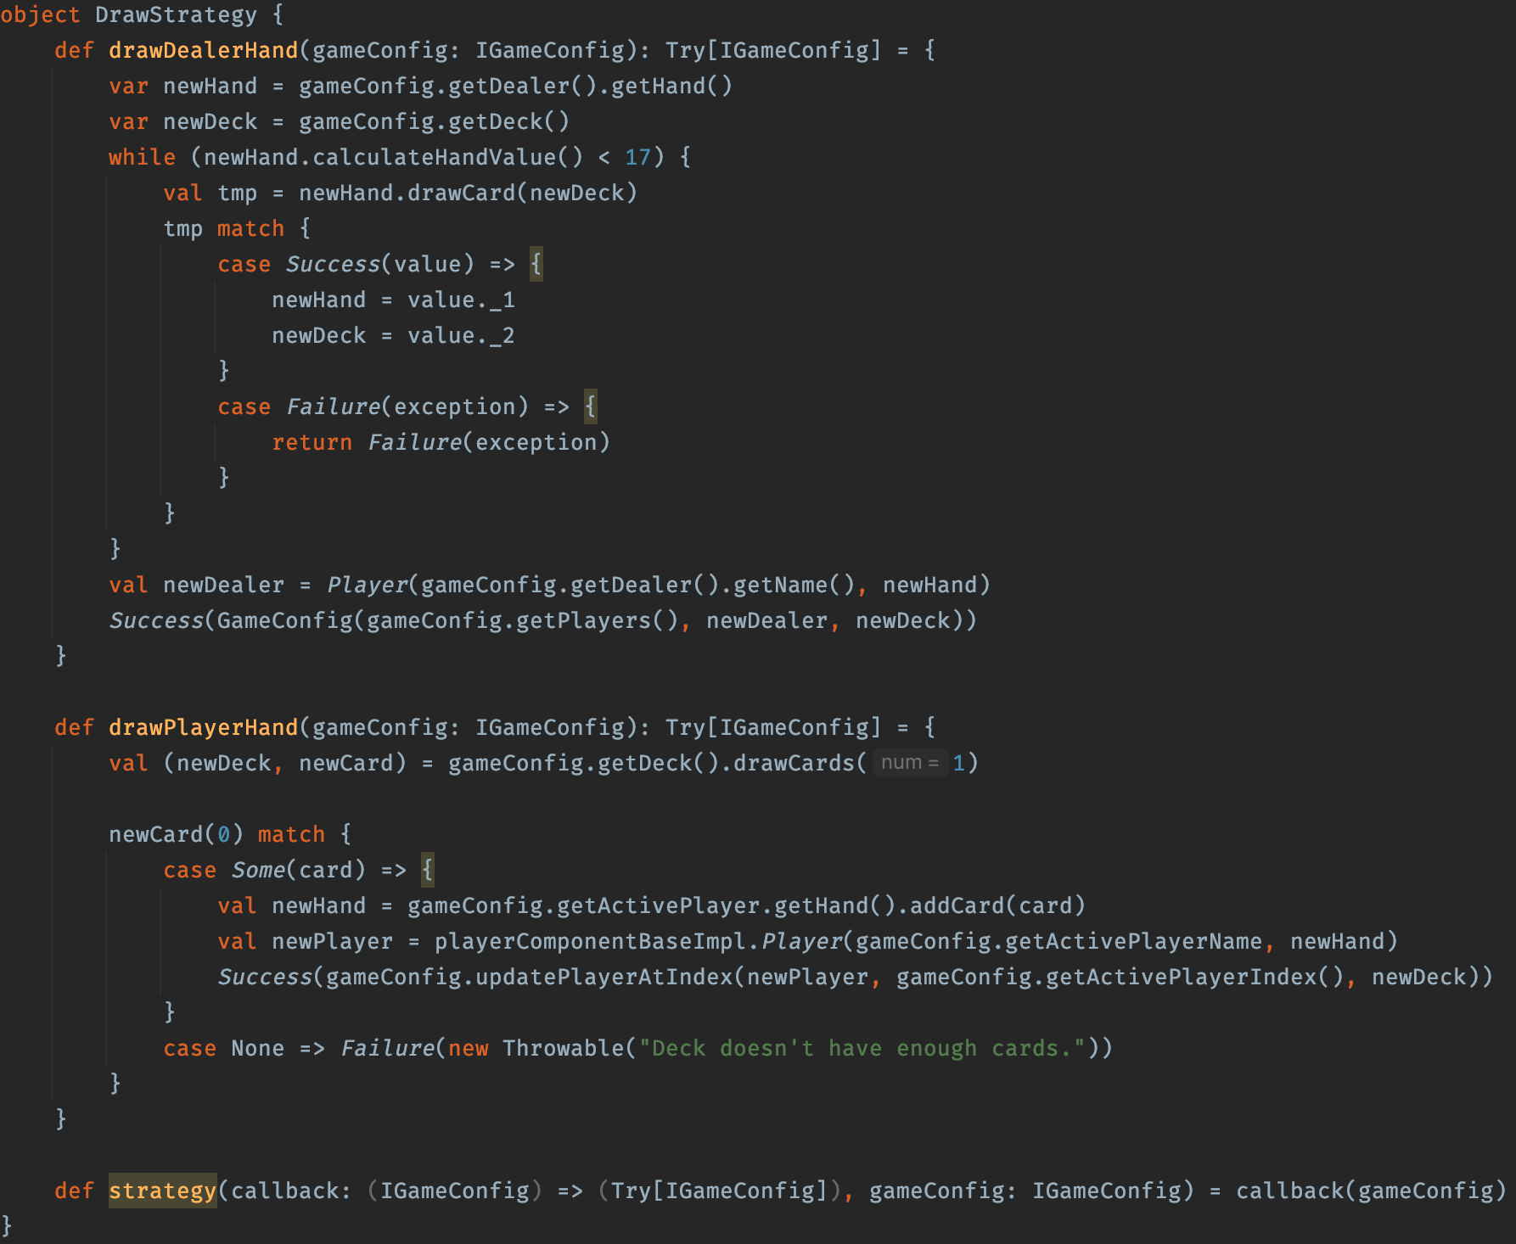
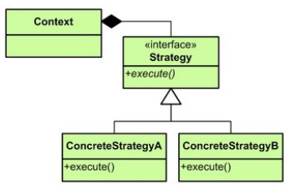
Pattern - Strategy Pattern
#7.3

Slide 13
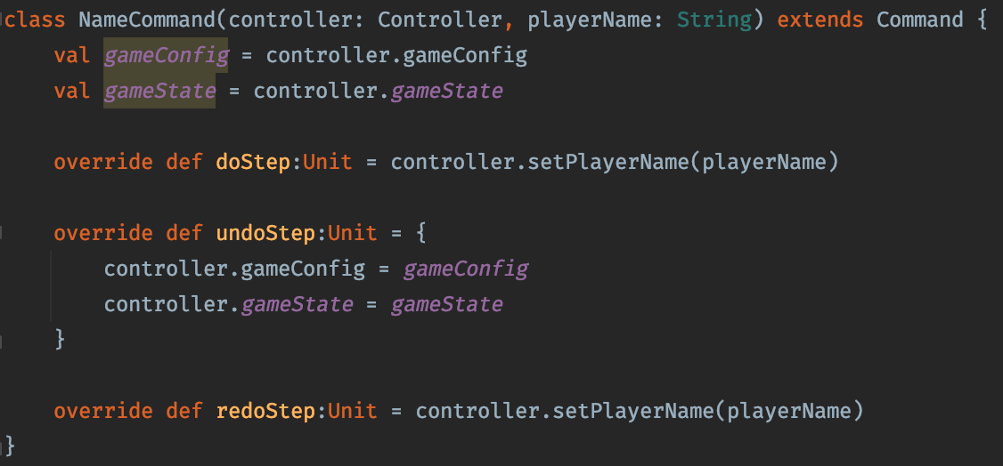
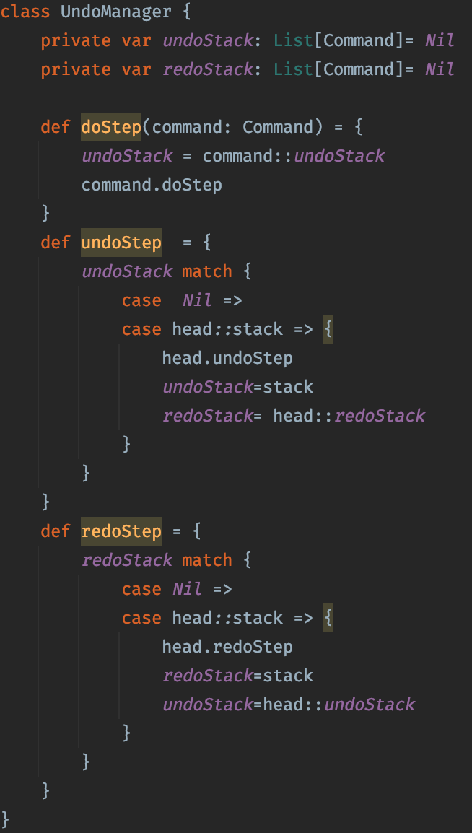
Undo/Redo Pattern
#8.1
Also implemented as player amount command

Slide 14
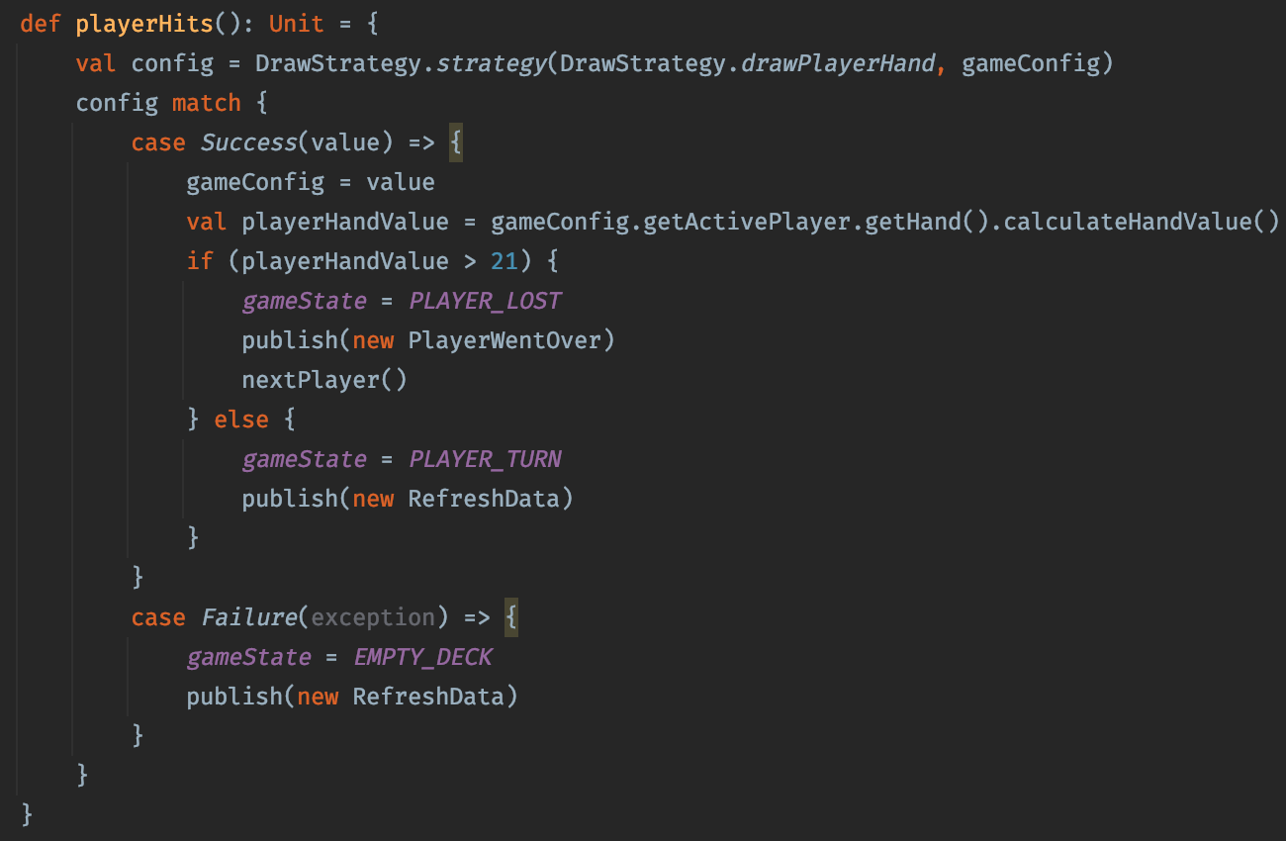
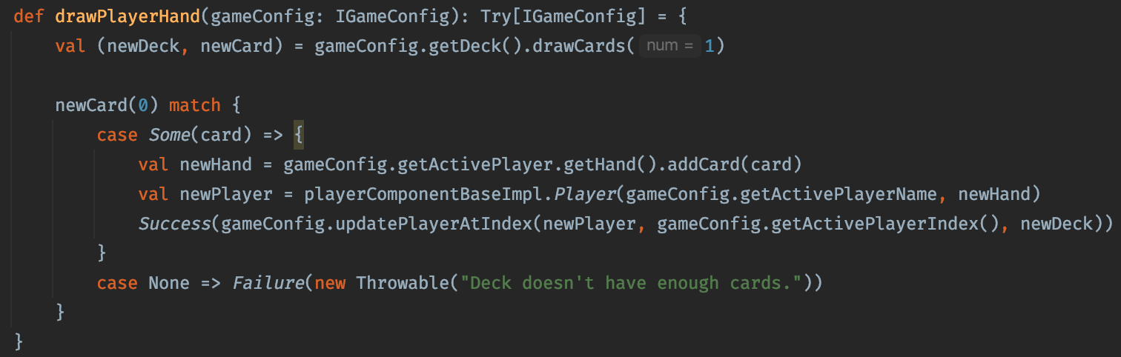
Option/Try
#8.2

Slide 15
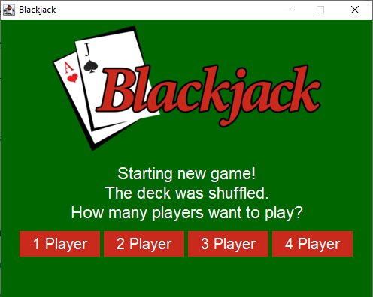
GUI
#9.1

Slide 16
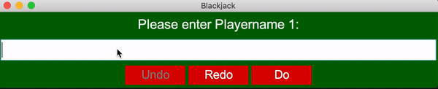
GUI
#9.2

Slide 17
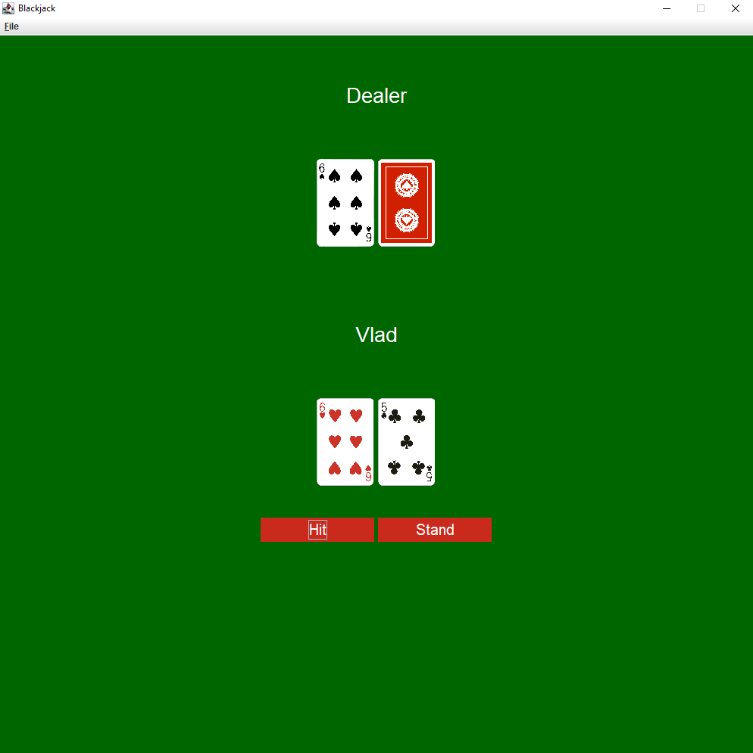
GUI
#9.3

Slide 18
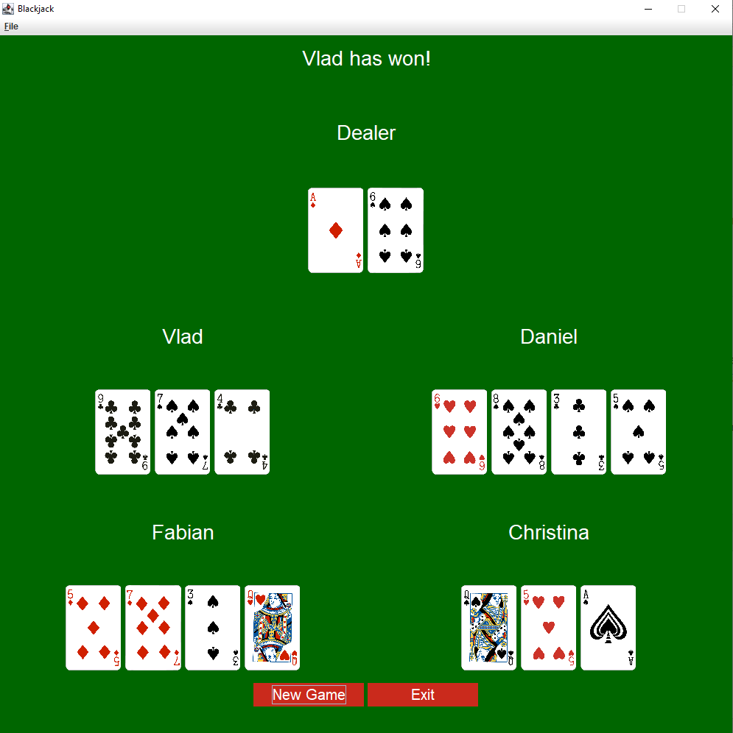
GUI
#9.4

Slide 19
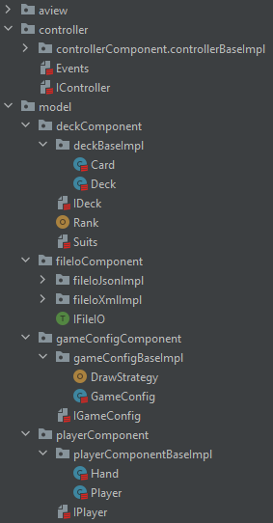
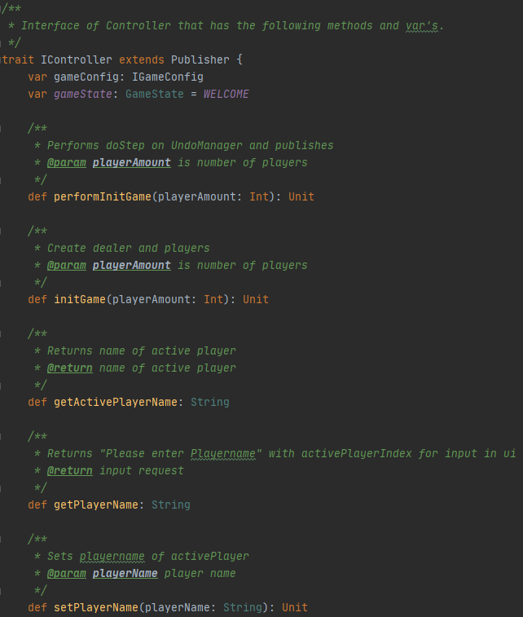
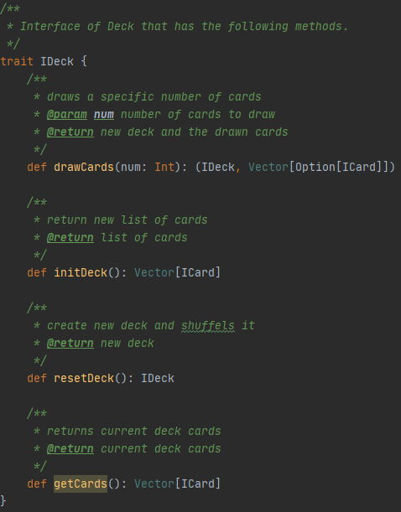
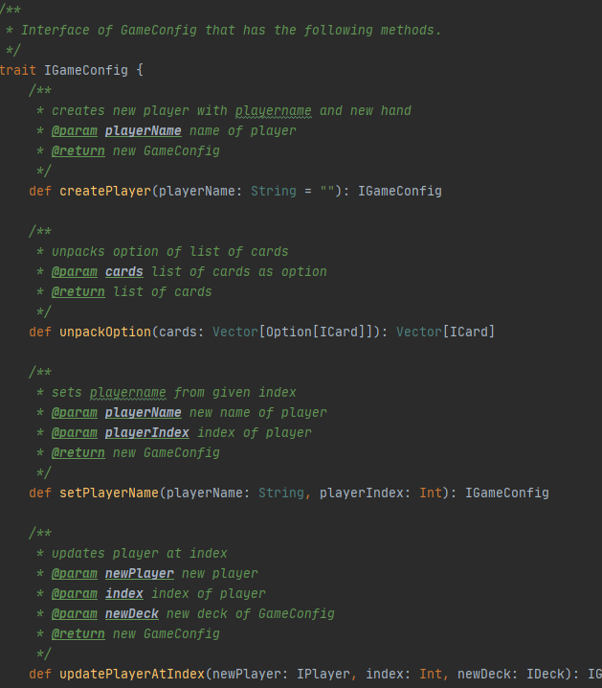
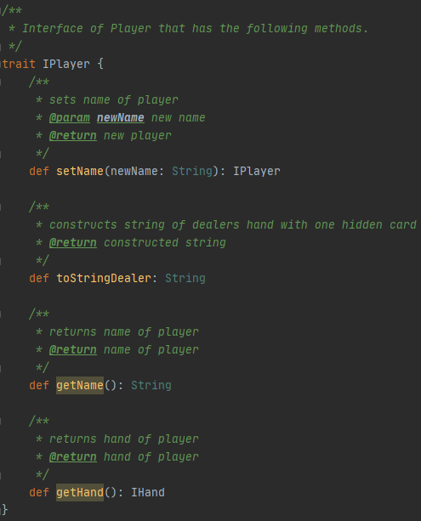
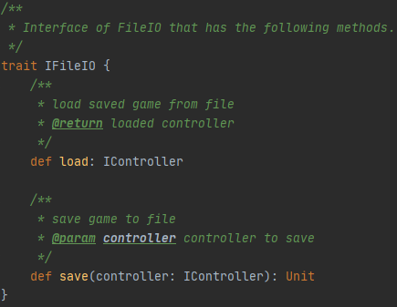
Components
#10

Slide 20
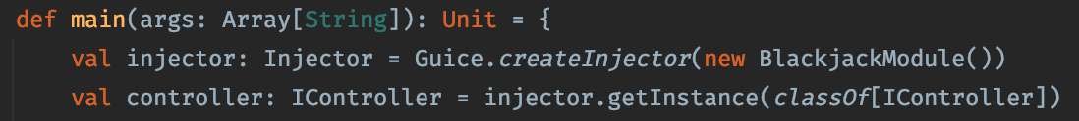
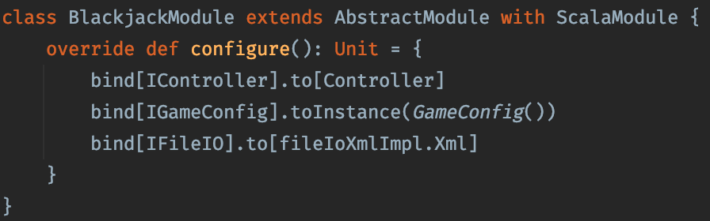
Dependency Injection
#11

Slide 21
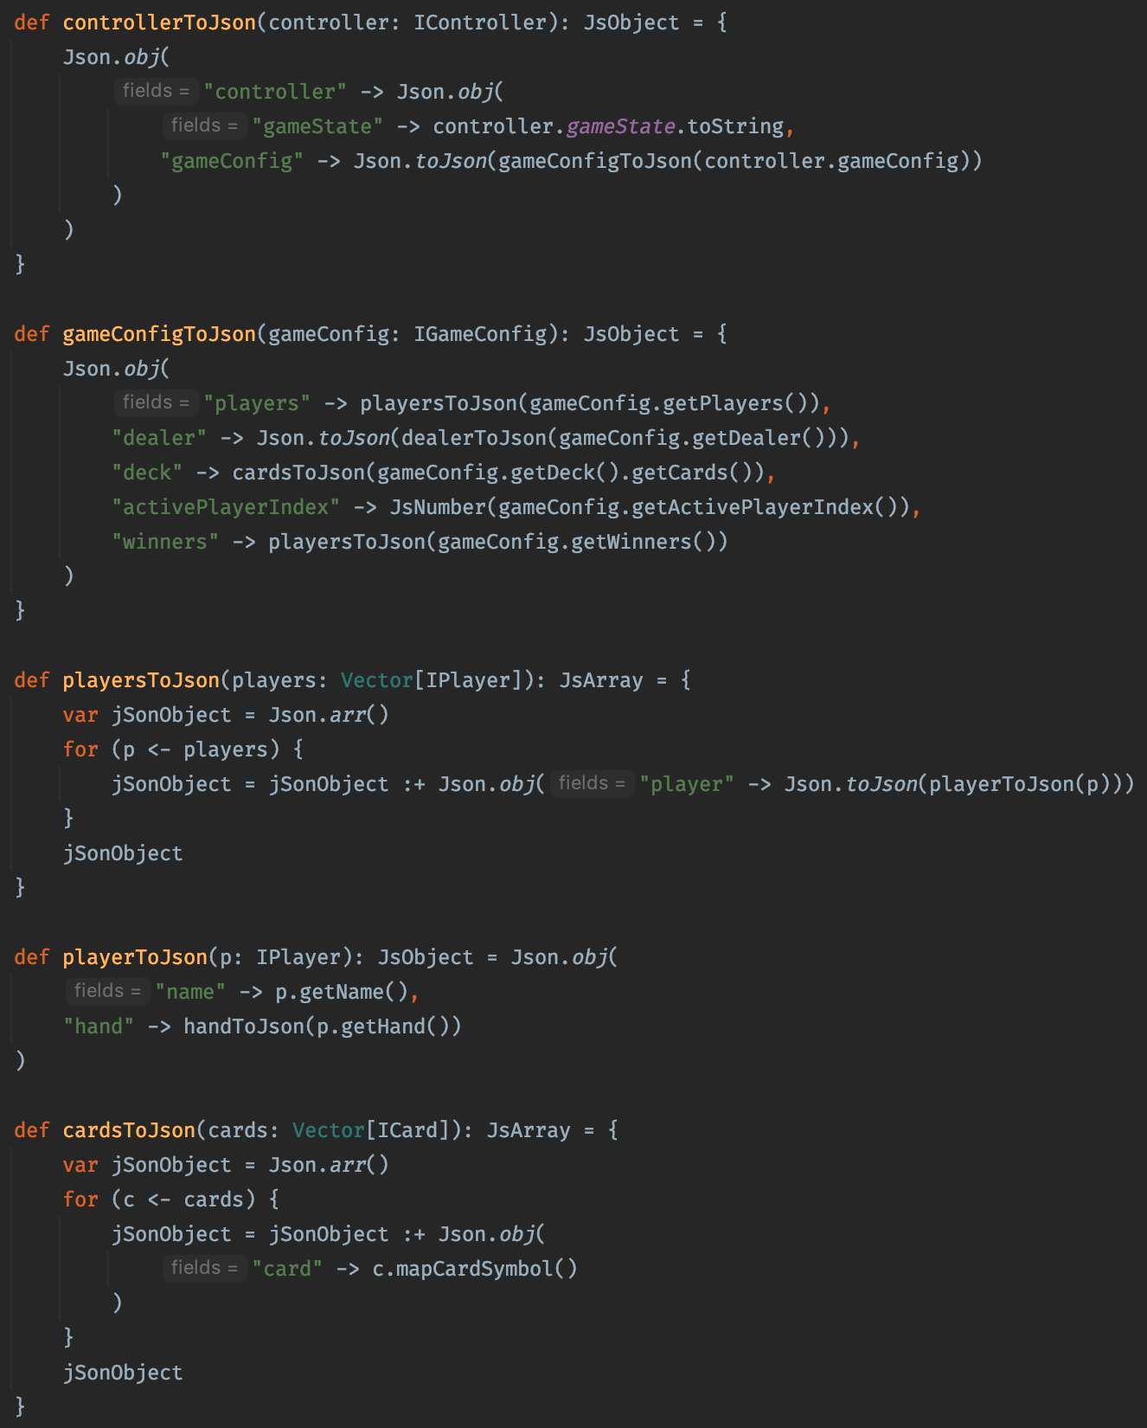
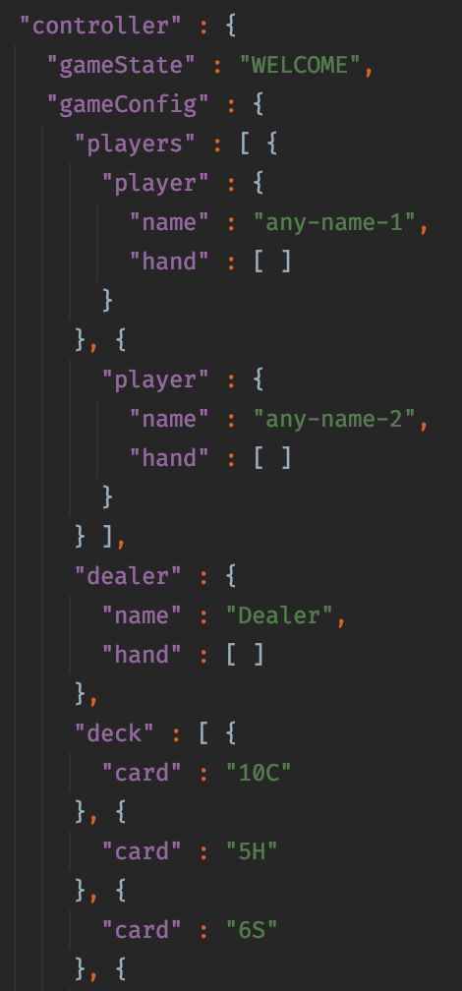
FileIO - JSON
#12.1

Slide 22
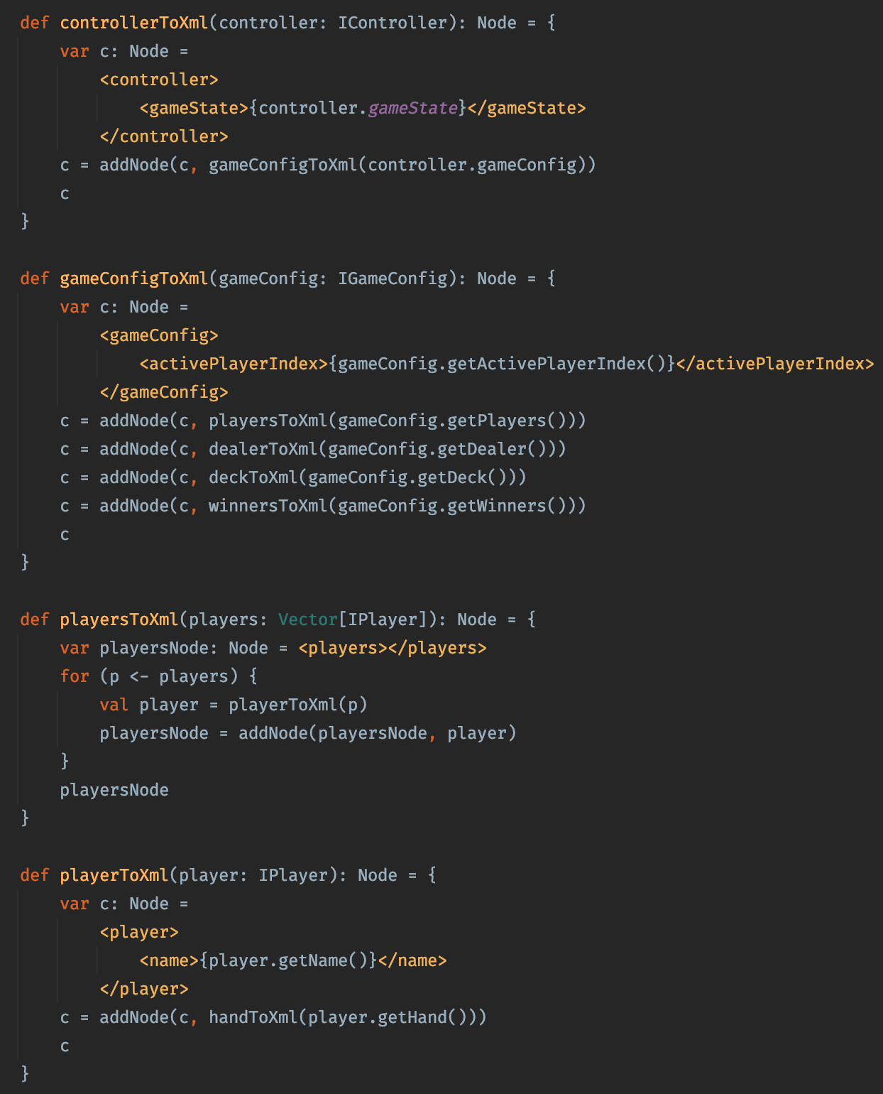
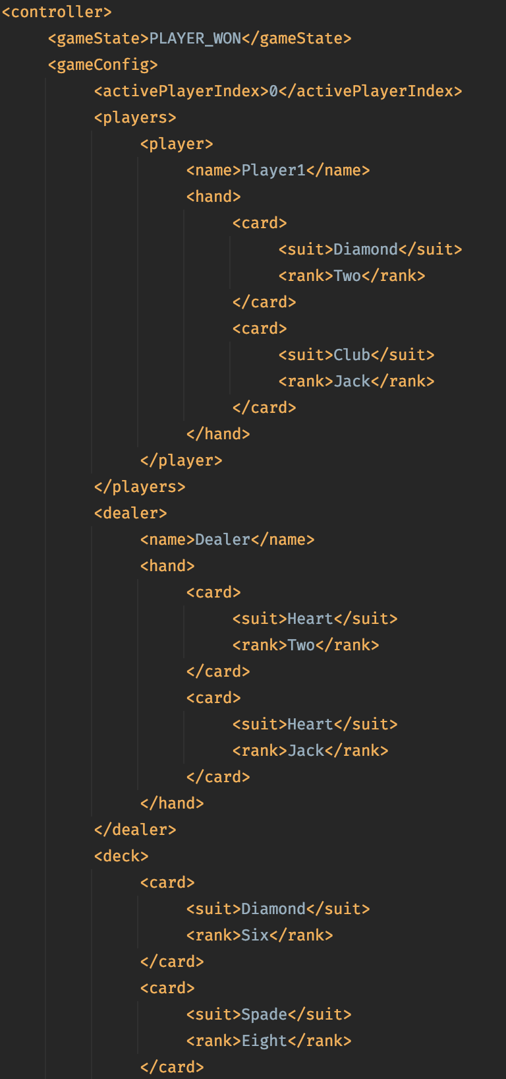
FileIO - XML
#12.2

Slide 23

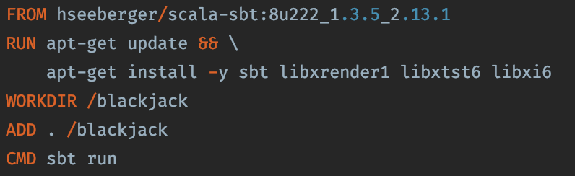

Docker
#13
Works also with GUI
Build/Run:
docker build -t blackjack .
docker run -e DISPLAY=$ip:0 -v /tmp/.X11-unix:/tmp/.X11-unix -ti blackjack:v1

Slide 24
THANKS FOR LISTENING
Questions?

